Slide 1
Day 22 Task Presentation Deck.
Task -
Complete an end-to-end analytics project with a presentation deck
Presented By -
Sankalp Parasharam Chougule
Data Analyst Intern

Slide 2
Task Overview
Analyze Airbnb dataset .
To Understand factors affecting price.
Build end to end pipeline.

Slide 3
Dataset Overview
The dataset was downloaded from Kaggle.
The dataset has 102058 rows and 24 columns.
Tools Used
Jupyter lite - Cleaning and EDA
Power Bi - Dashboard Creation

Slide 4
Downloaded the dataset from the source.
Imported the dataset into the Jupyter lite for cleaning and to perform basic EDA operations.
Performed basic operations to get data insights.
Dataset is the dirty dataset it has to many missing values.
Handled missing values.
Saved cleaned csv file.
Import the CSV file into Power Bi to create dashboard.

Slide 5
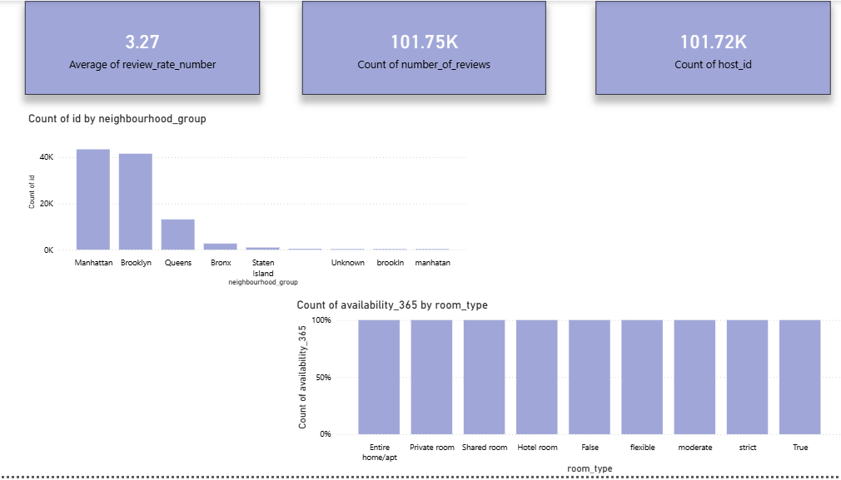
Simple Dashboard

